Slide 1
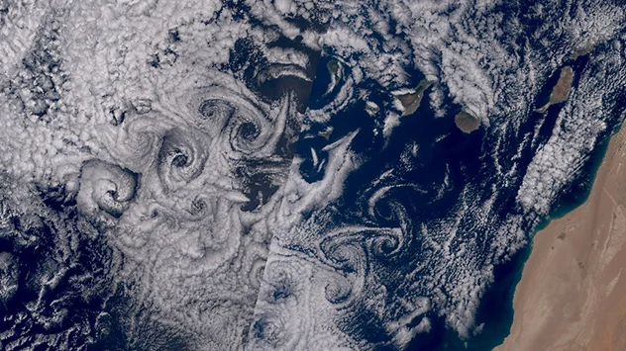
Theodore von Kármán and his Influence on Atmospheric Turbulence Research
Thomas Foken
University of Bayreuth
BayCEER
Hungarian Meteorological Society, 29 November 2023
19 March 2023, NASA-NOAA Suomi NPP Satellite

Slide 2
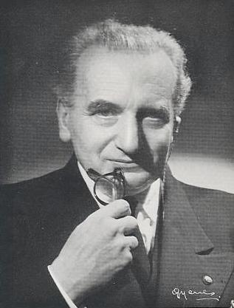
11 May 1881: Born in Budapest
1902: Royal Joseph Technical University Budapest
1908: PhD University of Göttingen (Ludwig Prandtl)
1909: Director of the Aeronautical Institute at RWTH Aachen
1922: Organisation of the international conference in Insbruck
1926: California Institute of Technology
1930: Director of the Aeronautical Laboratory of CalTech
1930: Emigration
1944: Left CalTech, different advisory positions
1962: National Medal of Science (J. F. Kennedy)
06 May 1963: Died during a trip in Aachen
© A. Filippone (1996-2001): Advanced Topics in Aerodynamics
https://aerodyn.org/vonkarman/

Slide 3
Born-von Kármán lattice model (crystallography)
von Kármán street (flow past cylinder)
von Kármán integral equation (boundary layers)
Kármán-Pohlhausen parameter (boundary layers)
von Kármán-Tsien compressibility correction
von Kármán ogive (supersonic aerodynamics)
Kármán-Treffz transformation (airfoil theory)
Kármán-Nikuradse correlation (viscous flow)
Prandtl-von Kármán law (velocity in open channel flow)
Chaplygin-Kármán-Tsien approximation (potential flow)
Falkowich-Kármán equation (transonic flow)
© A. Filippone (1996-2001): Advanced Topics in Aerodynamics
https://aerodyn.org/vonkarman/

Slide 4
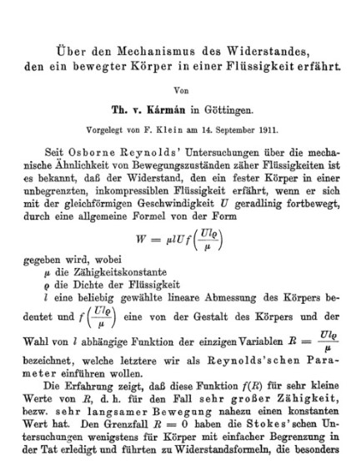
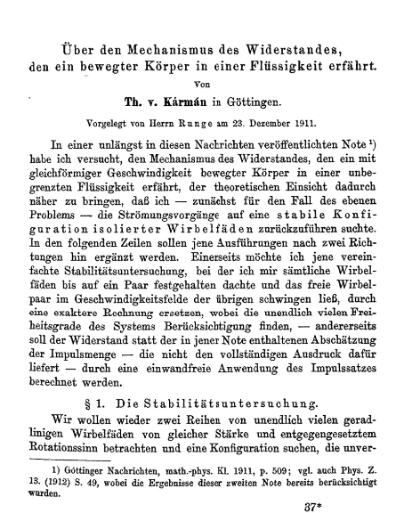
Kármán Vortex Street
Nachrichten von der Gesellschaft der Wissenschaften zu Göttingen, Mathematisch-Physikalische Klasse (1911)
Volume: 1911, page 509-517
Nachrichten von der Gesellschaft der Wissenschaften zu Göttingen, Mathematisch-Physikalische Klasse (1912)
Volume: 1912, page 547-556

Slide 5


Von Kármán Boundary-Layer Momentum Integral Equation (1921)
It is valid for steady laminar boundary layers and for time-averaged flow in turbulent boundary layers.
T. v. Karman, Über laminare und turbulente Reibung, J. Appl. Math. Mech., 1, 233–252 (1921).
K. Pohlhausen, Zur näherungsweisen Integration der Differentialgleichung der laminaren Grenzschicht, J. Appl. Math. Mech., 1, 252–290 (1921).
D. B. Marghitu: Mechanical Engineer's Handbook, Academic Press Series in Engineering, 2001, Pages 445-557

Slide 6
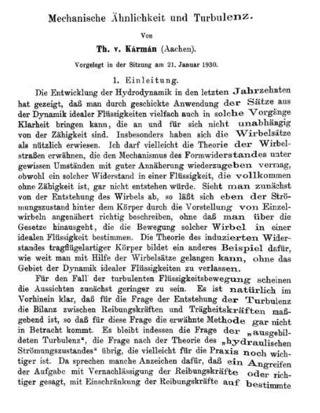
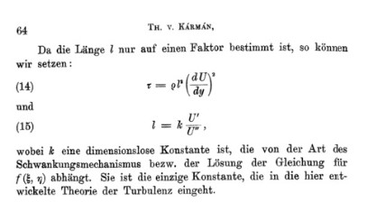
Equation of a Wind Profile Near a Wall (1930)
Prandtl had a slightly different approach, but accepted Kármán's theory with k = 0.40 in 1933.
Neuere Ergebnisse der Turbulenzforschung, Z. Ver. dtsch. Ing. 77 (1933), 105-114.
where k is a dimensionless constant that depends on the type of fluctuation mechanism or the solution of the equation. It is the only constant that is included in the theory of turbulence developed here.
Nachrichten von der Gesellschaft der Wissenschaften zu Göttingen, Mathematisch-Physikalische Klasse (1930) , Volume: 1930, page 58-76

Slide 7
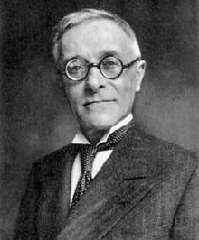
Theodore von Kármán
(1881 – 1963)
Tullio Levi-Civita
(1873 – 1941)

Slide 8
Count of important terms
Atmosphäre – Atmosphere (0)
Normalatmosphäre – Normal atmosphere (1)
Meteorologie – Meteorology (0)
Reynold (40)
Taylor (1)
Richardson (1)
Schmidt, Wilhelm (2)

Slide 9
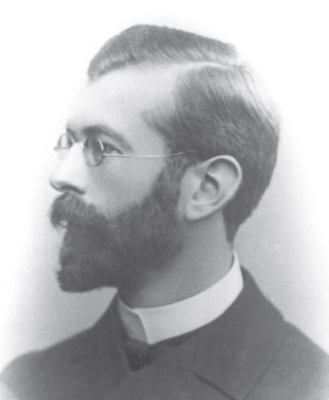

In the elucidation of the laws of this turbulence friction one has not come far, in spite of remarkable works of W. Schmidt, Taylor, Richardson and others, no progress has been made. In the shall be assumed that the current movement – apart from the turbulence motions – simply proceeds as according to the Navier's equations, except that the friction coefficient µ is very much increased because of the turbulence and is also may be variable in time and space.
1874 – 1954

Slide 10
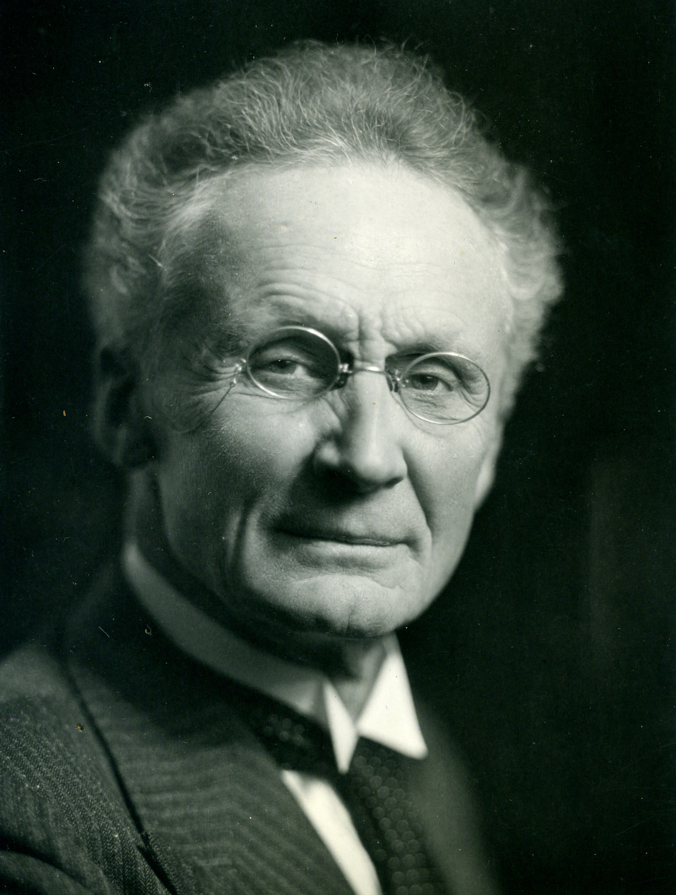
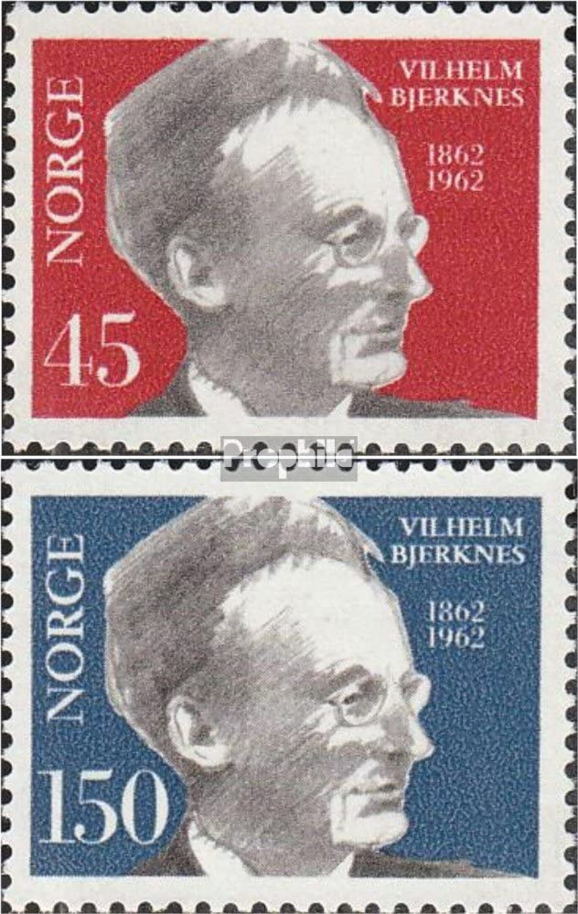
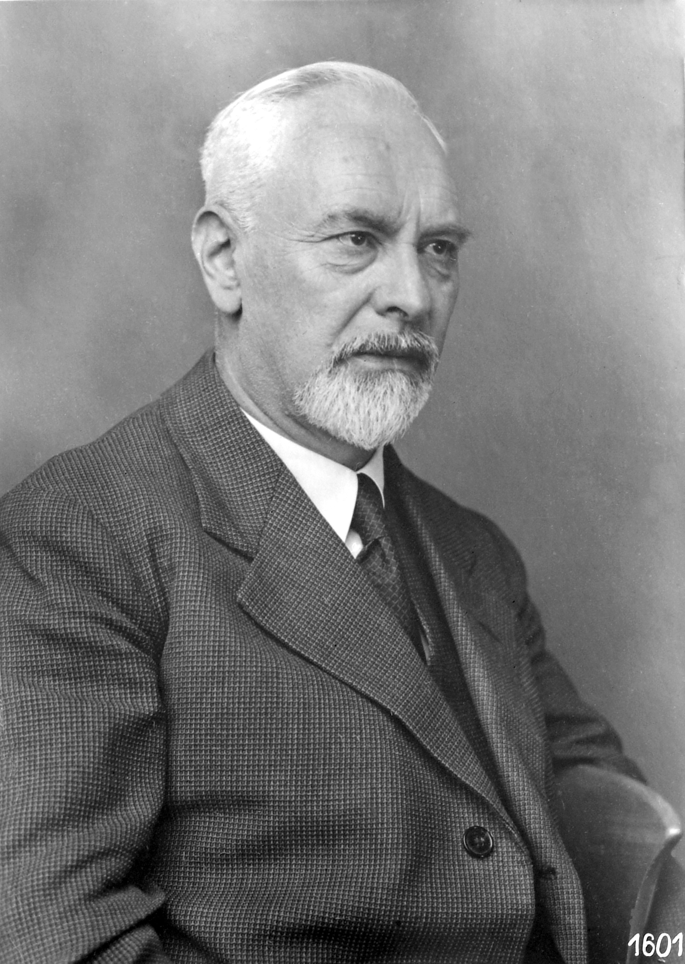
1875 – 1953
1862 – 1951
© CC-BY-SA-4.0
© DLR, CC-BY 3.0

Slide 11
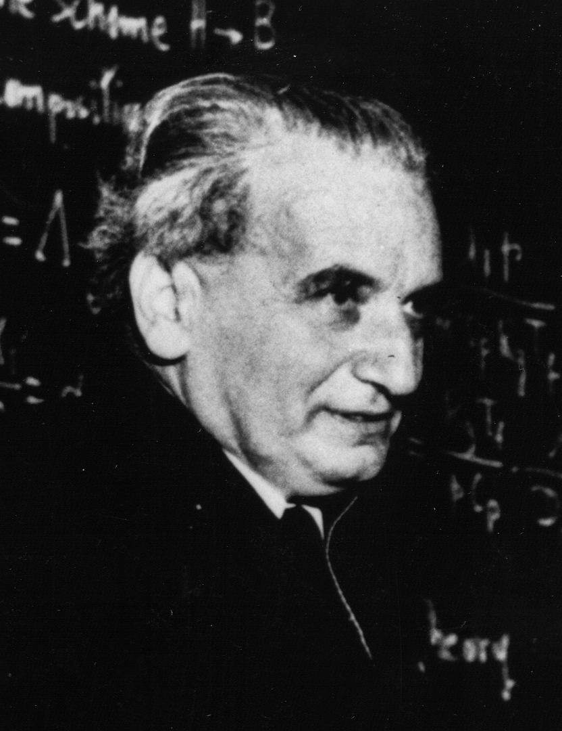
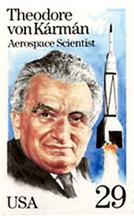
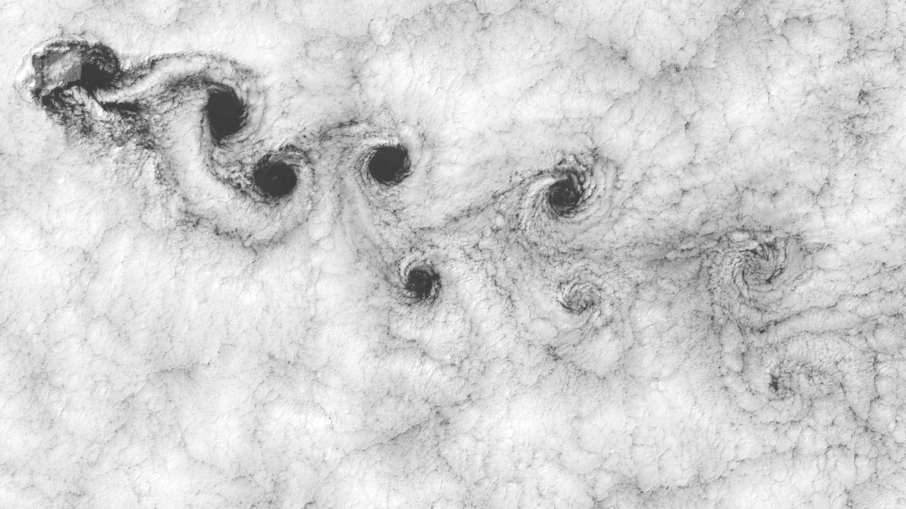
For the flow form with discrete vortex formations and certain periods, the phenomenon of the "vortex street" provides a characteristic example, which occurs during the movement of an infinitely extended cylinder in a liquid, and whose stability I have proved in an earlier work.
1881 – 1963
© NASA, GFSC

Slide 12
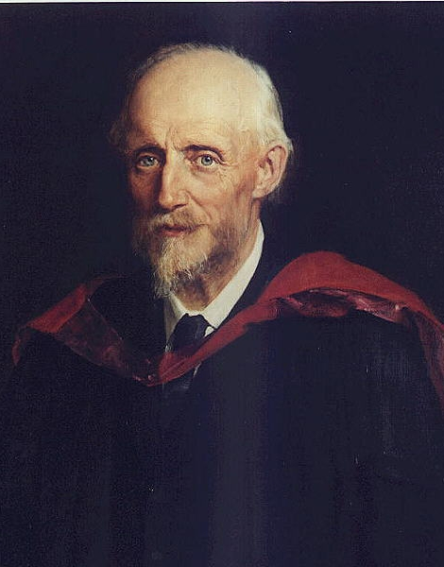

Reynolds number
Reynolds decomposition
1842 – 1912
not Germany and Switzerland
Reynolds O (1895) On the dynamical theory of turbulent incompressible viscous fluids and the determination of the criterion. Phil Trans R Soc London. A 186:123-164 https://doi.org/10.1098/rsta.1895.0004

Slide 13
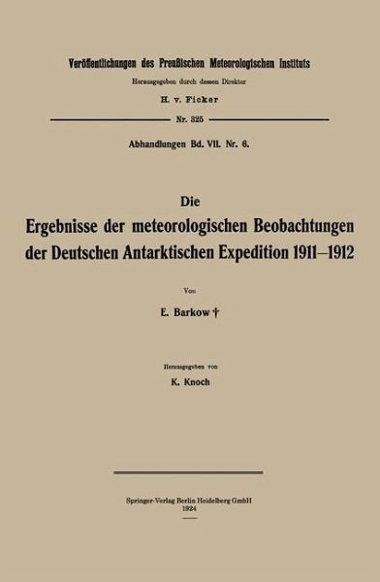
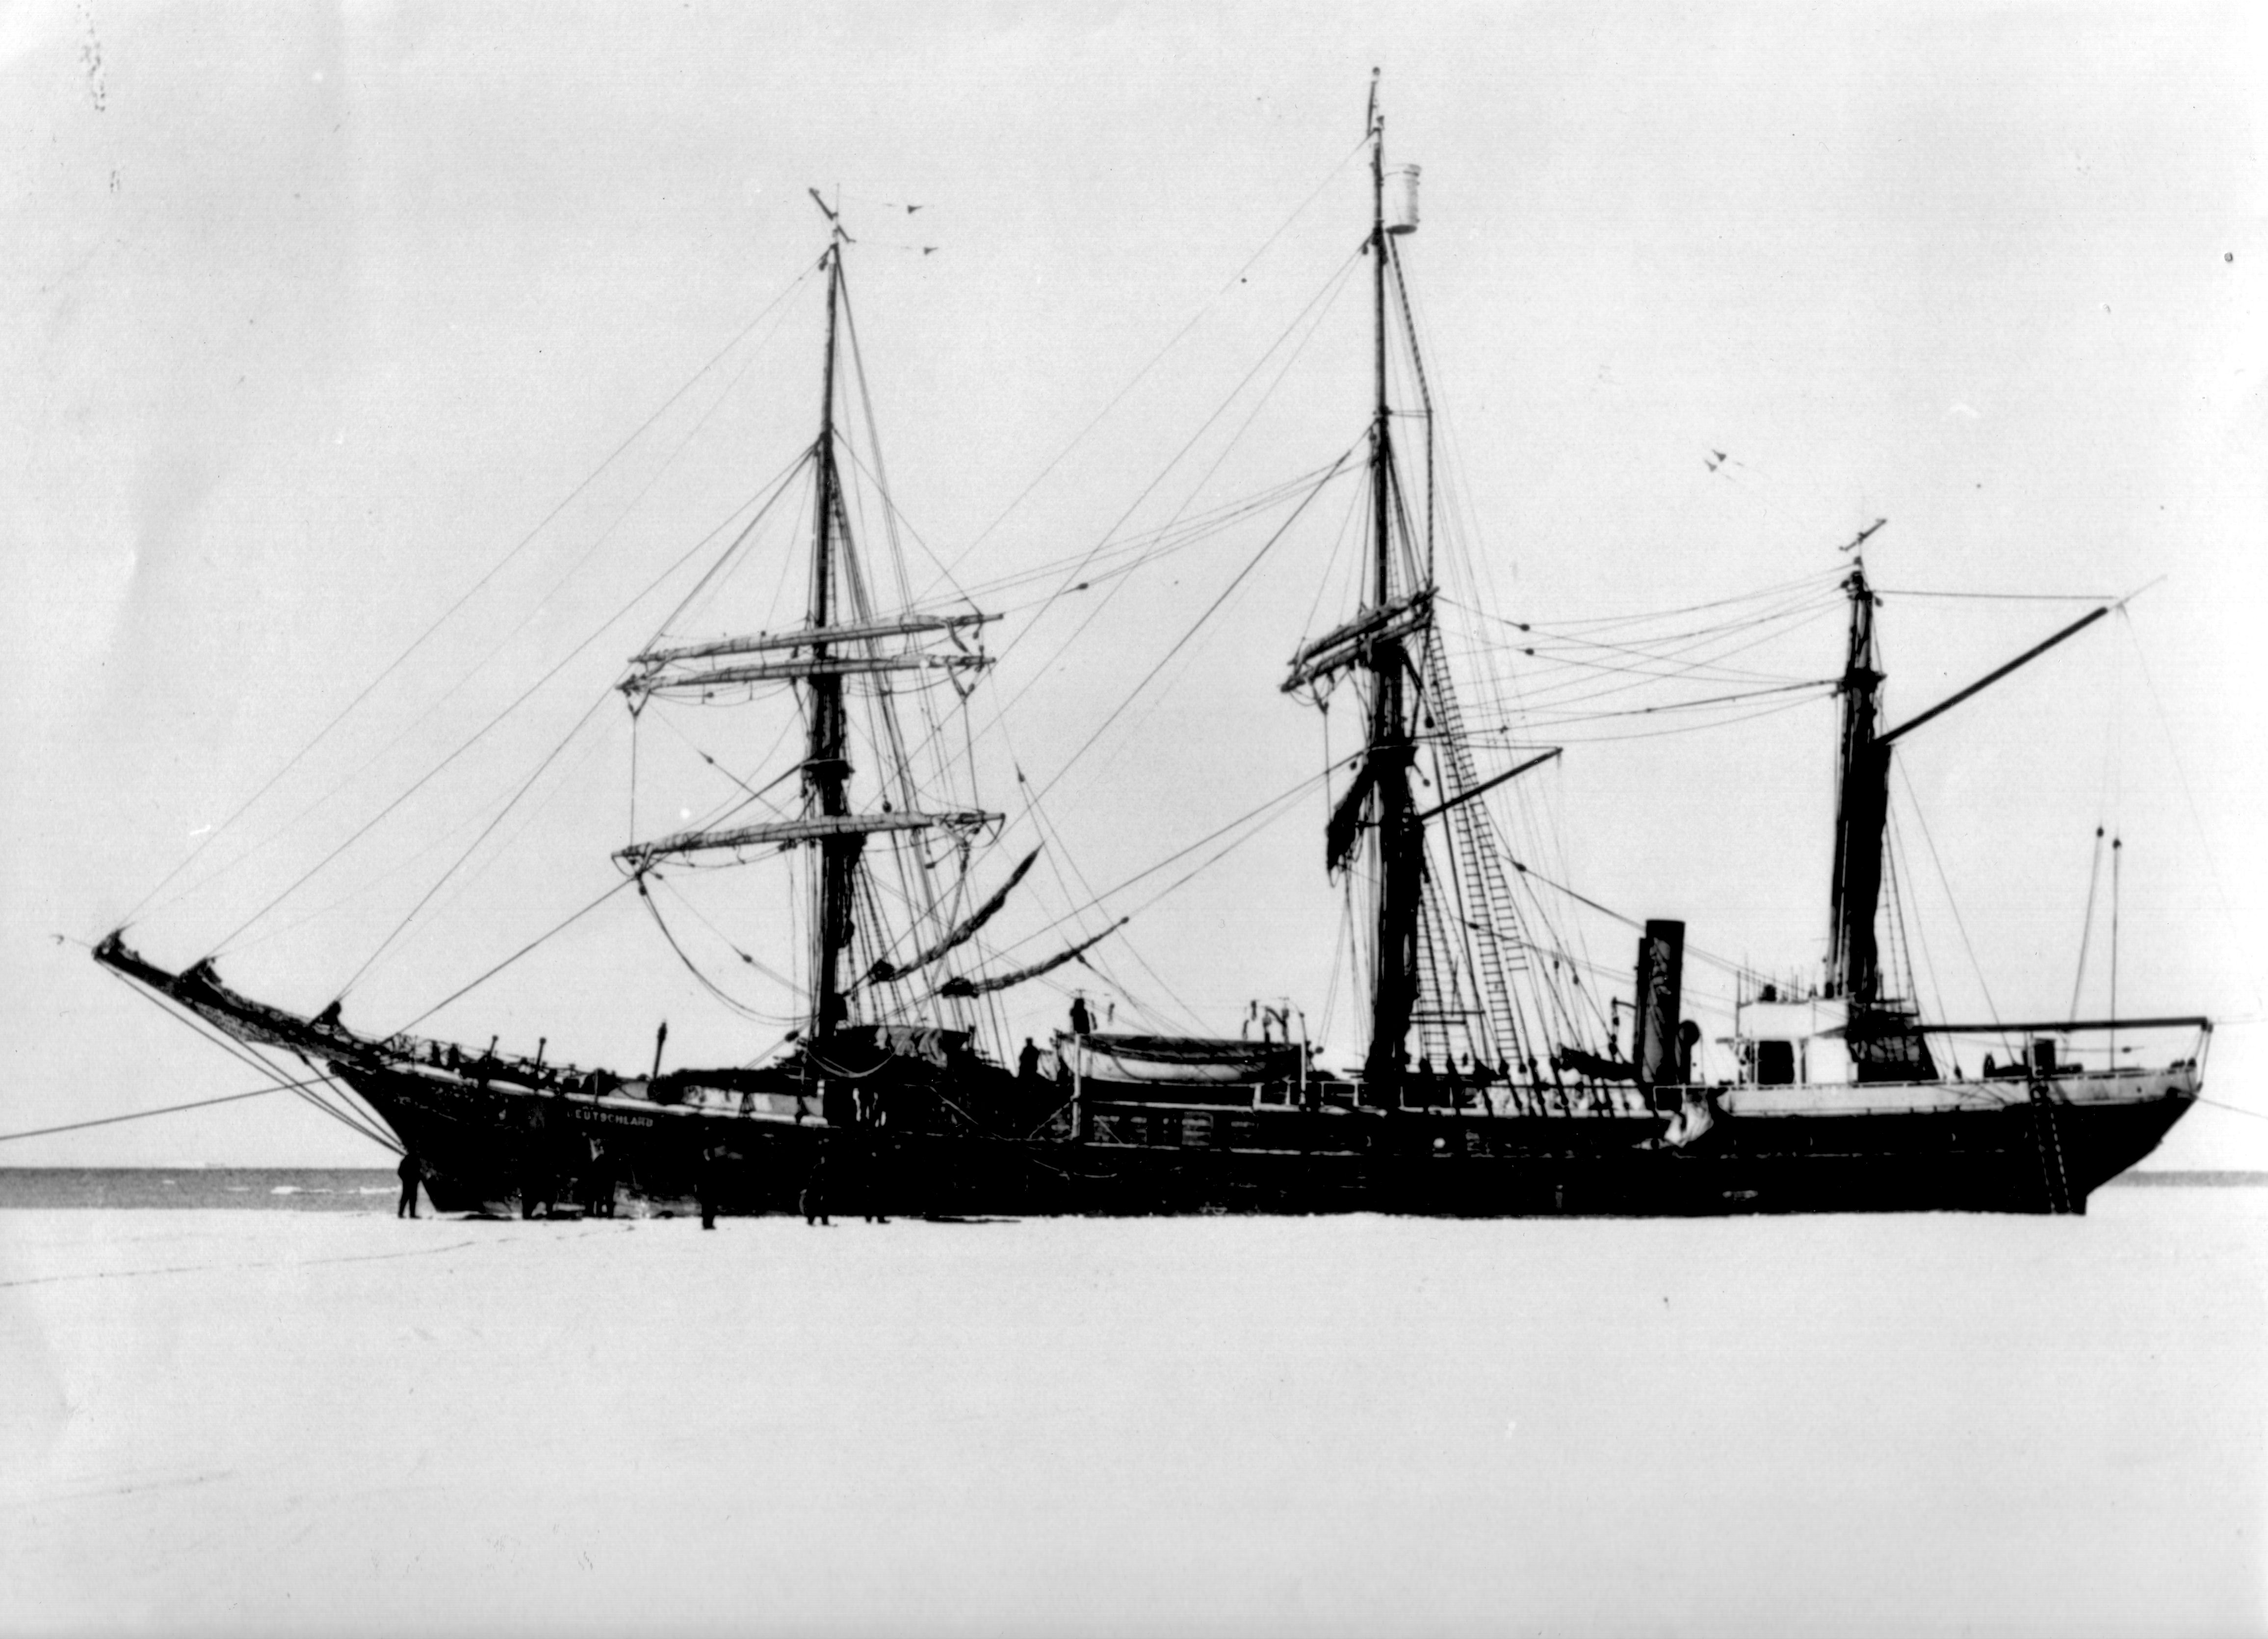
The curves clearly show how variable an element of wind turbulence is. Also one can read from this representation the already known fact that directional fluctuations and wind speed go parallel at rough observation.
During 9 months in 1911/1912 the “Deutschland” trapped in the ice of the Weddell Sea. Erich Barkow studied during this time the wind recordings at the Potsdam Observatory.
Erich Barkow
1882 – 1923
Barkow E (1912) Untersuchungen über die Struktur des Windes. Bericht über die Tätigkeit des Königlich-Preußischen Meteorologischen Instituts im Jahr 1912:58-77

Slide 14
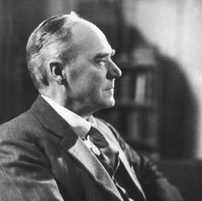
1915 – 1921
Sir Geoffrey Ingram Taylor
Taylor GI (1915) Eddy motion in the atmosphere. Phil Trans R Soc London. A 215:1-26 https://doi.org/10.1098/rsta.1915.0001
Taylor GI (1922) Diffusion by Continuous Movements. Proceedings of the London Mathematical Society. s2-20:196-212 https://doi.org/10.1112/plms/s2-20.1.196
© 1886 – 1975
1935 – 1940
Taylor GI (1938) The spectrum of turbulence. Proceedings Royal Society London. A 164:476-490 https://doi.org/10.1098/rspa.1938.0032

Slide 15
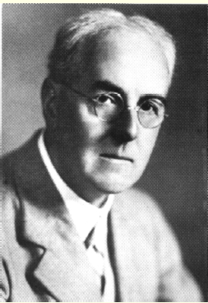
Lewis Fry Richardson
1881 – 1953
Richardson LF (1925) Turbulence and vertical temperature difference near trees. The London, Edinburgh, and Dublin Philosophical Magazine and Journal of Science. 49:81-90 https://doi.org/10.1080/14786442508634581

Slide 16
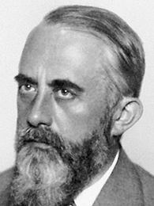
Wilhelm Matthäus Schmidt
Here we have now the desired formula; the flux is represented as the product of two factors; one is the gradient of the property s at the point under consideration; the second is quite independent of the particular property, describes or measures alone the physicality of the exchange between vertically adjacent layers, it is nothing else than the magnitude of the exchange previously denoted by A. It is therefore again
(1)
in which A has the dimension in the absolute system of measurement cm⁻¹ g sec⁻¹.
1883 – 1936

Slide 17
Ludwig Prandtl
Meteorological Application of Fluid Mechanics
By L. Prandtl, Göttingen
On the occasion of the 70th birthday of our esteemed Mr. Bjerkness, I gladly accepted the invitation to contribute to the planned jubilee booklet, since we venerate in Mr. Bjerkness the old master of meteorological mechanics and fluid mechanics. However, I do not have anything really mature in stock at the moment, and so I ask him to make do with some more program-like remarks. …
1875 – 1953
Prandtl L (1932) Meteorologische Anwendung der Strömungslehre. Beitr Phys freien Atmosphäre. 19:188-202

Slide 18
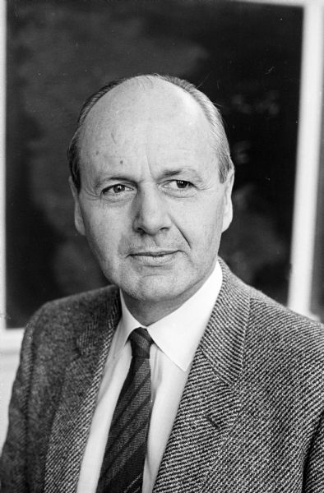
Heinz Lettau
1931 PhD at the University of Leipzig
1933 – 1938 Assistant of Prof. Weickmann at Leipzig
1938 Head Observatory Groß Raum (Univ. Königsberg)
WWII Calculation of ballistic winds based on wind-profile and turbulence data for rocket launches
1944/45 American prisoner
1945/47 Weather Service of US zone
1947 – 1957 Massachusetts Institute of Technology
1953 O’Neill experiment
1957 Book: Exploring the atmosphere’s first mile of the atmosphere
1957 – 1980 Professor of Meteorology at the University of Wisconsin
1970 Editorial board member “Boundary-Layer Meteorology”
1909 – 2005

Slide 19
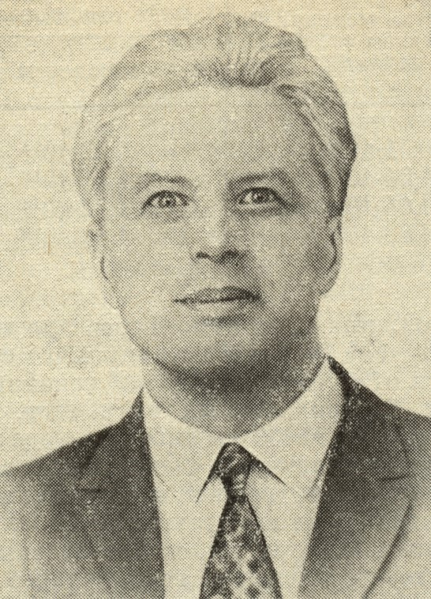
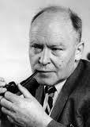
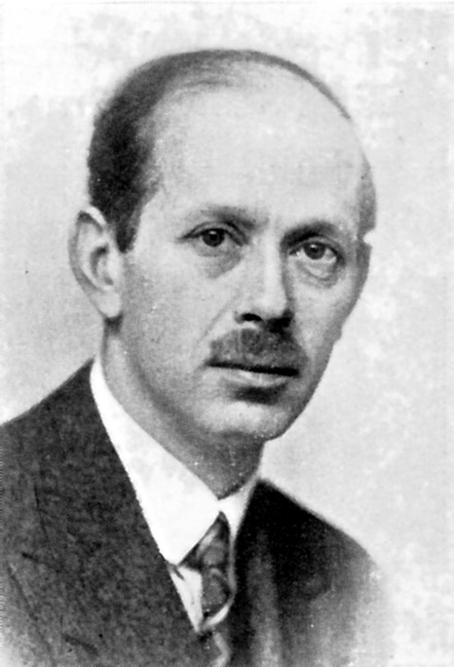
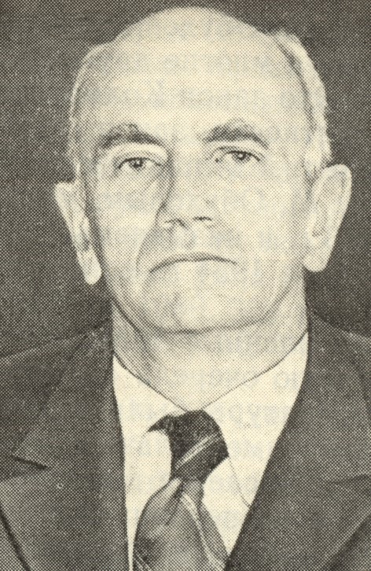
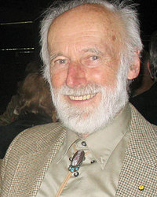
Surface Layer Fluxes
T. v Kármán
1881 - 1963
A.S. Monin
1921 - 2007
J.C. Kaimal
1930 - 1921
J.C. Wyngaard
* 1938
A.M..
Obukhov
1918 –
1989
H.U.
Sverdrup
1888 - 1957
H.Lettau
1909 –
2005
A.M..
Obukhov
1918 - 1989
V.M.
Bovsheverov
1905 - 1995
S.S.
Zilitinkevich
1936 - 1921
J.A.
Businger
*1924
W. Schmidt
1883 - 1936
C.-G. Rossby
1898 - 1957
U. Högström.
*1932
1920
1930
1940
Obukhov
Length
1950
1960
1970
1980
1990
Exchange
coefficient
Flux
calculation
Similarity
Theory
Sonic
anemometer
Universal
function
Corrected
universal function
Obukhov-Lettau
Stability parameter

Slide 20
A.S. Monin
1921 - 2007
J.C. Kaimal
1930 - 1921
J.C. Wyngaard
* 1938
Surface Layer Fluxes
A.M..
Obukhov
1918 –
1989
H.U.
Sverdrup
1888 - 1957
H.Lettau
1909 –
2005
A.M..
Obukhov
1918 - 1989
V.M.
Bovsheverov
1905 - 1995
S.S.
Zilitinkevich
1936 - 1921
J.A.
Businger
*1924
W. Schmidt
1883 - 1936
C.-G. Rossby
1898 - 1957
U. Högström.
*1932
1920
1930
1940
Obukhov
Length
1950
1960
1970
1980
1990
Exchange
coefficient
Flux
calculation
Similarity
Theory
Sonic
anemometer
Universal
function
Corrected
universal function
Obukhov-Lettau
Stability parameter
Foken T and Börngen M (2021) Lettau’s Contribution to the Obukhov Length Scale: A Scientific Historical Study. Boundary-Layer Meteorol. 179:369-383 https://doi.org/10.1007/s10546-021-00606-4

Slide 21
Surface Layer Fluxes
T. v Kármán
1881 - 1963
A.S. Monin
1921 - 2007
J.C. Kaimal
1930 - 1921
J.C. Wyngaard
* 1938
A.M..
Obukhov
1918 –
1989
H.U.
Sverdrup
1888 - 1957
H.Lettau
1909 –
2005
A.M..
Obukhov
1918 - 1989
V.M.
Bovsheverov
1905 - 1995
S.S.
Zilitinkevich
1936 - 1921
J.A.
Businger
*1924
W. Schmidt
1883 - 1936
C.-G. Rossby
1898 - 1957
U. Högström.
*1932
1920
1930
1940
Obukhov
Length
1950
1960
1970
1980
1990
Exchange
coefficient
Flux
calculation
Similarity
Theory
Sonic
anemometer
Universal
function
Corrected
universal function
Obukhov-Lettau
Stability parameter

Slide 22
A.S. Monin
1921 - 2007
J.C. Kaimal
1930 - 1921
J.C. Wyngaard
* 1938
Surface Layer Fluxes
A.M..
Obukhov
1918 –
1989
H.U.
Sverdrup
1888 - 1957
H.Lettau
1909 –
2005
A.M..
Obukhov
1918 - 1989
V.M.
Bovsheverov
1905 - 1995
S.S.
Zilitinkevich
1936 - 1921
J.A.
Businger
*1924
W. Schmidt
1883 - 1936
C.-G. Rossby
1898 - 1957
U. Högström.
*1932
1920
1930
1940
Obukhov
Length
1950
1960
1970
1980
1990
Exchange
coefficient
Flux
calculation
Similarity
Theory
Sonic
anemometer
Universal
function
Corrected
universal function
Obukhov-Lettau
Stability parameter
Foken T and Börngen M (2021) Lettau’s Contribution to the Obukhov Length Scale: A Scientific Historical Study. Boundary-Layer Meteorol. 179:369-383 https://doi.org/10.1007/s10546-021-00606-4

Slide 23
Surface Layer Fluxes
T. v Kármán
1881 - 1963
A.S. Monin
1921 - 2007
J.C. Kaimal
1930 - 1921
J.C. Wyngaard
* 1938
A.M..
Obukhov
1918 –
1989
H.U.
Sverdrup
1888 - 1957
H.Lettau
1909 –
2005
A.M..
Obukhov
1918 - 1989
V.M.
Bovsheverov
1905 - 1995
S.S.
Zilitinkevich
1936 - 1921
J.A.
Businger
*1924
W. Schmidt
1883 - 1936
C.-G. Rossby
1898 - 1957
U. Högström.
*1932
1920
1930
1940
Obukhov
Length
1950
1960
1970
1980
1990
Exchange
coefficient
Flux
calculation
Similarity
Theory
Sonic
anemometer
Universal
function
Corrected
universal function
Obukhov-Lettau
Stability parameter

Slide 24
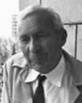
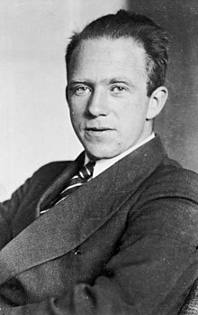
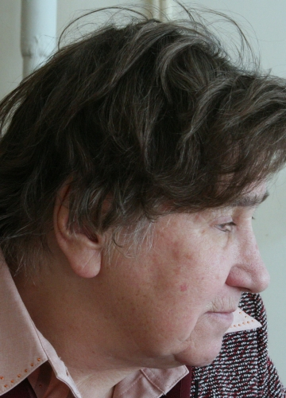
Statistical Turbulence
C.F. v. Weizäcker
1912 - 2007
S. Corrsin
1920 - 1986
V.I. Tatarskii
1929 - 2020
T. v Kármán
1881 - 1963
A.N.
Kolmogorov
1903 - 1987
A.M..
Obukhov
1918 - 1989
A.M..
Obukhov
1918 - 1989
M.A.
Kallistratova
* 1931
G.I. Taylor
1886 - 1975
W. Heisenberg
1901 - 1976
A.A. Townsend
1917 - 2010
1920
1930
1940
1945
1950
1955
1960
1965
Local
Isotropy
(Scalars)
Wave
Propagation
Structure
Function/Fluxes
Turbulence
Spectrum
Local
Isotropy
(Wind)
Reynolds
Similarity
Hypothesis
Sodar
G.K. Batchelor
1920 - 2000

Slide 25

Session: 100 Years of Turbulence
TOPIC: 100 Years of Atmospheric Turbulence Research
Author: Thomas Foken
Coherent Structures
H. Von
Helmholtz
1821 - 1894
F.T.M.
Nieuwstadt
1946 - 2005
Lord Kelvin
1824 - 1907
D. Brunt
1886 - 1965
V. Väisälä
1889 - 1969
J.W. Deardorff
1928 - 2014
M. Raupach
1950 - 2015
J. Finnigan
Basics:
Kelvin-Helmholtz
Instability
Basics:
Brunt-Väisäla
Frequency
1970
1980
1990
2000
Counter
Gradient
Flux
Stable
Strati-
fication
K-H-Instability
Canopy Flow

Slide 26

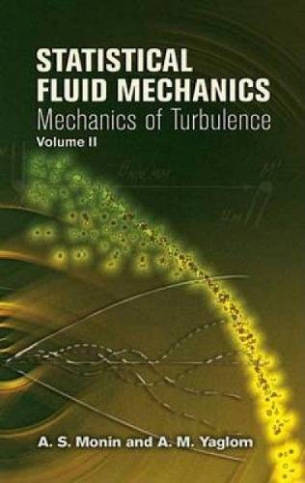

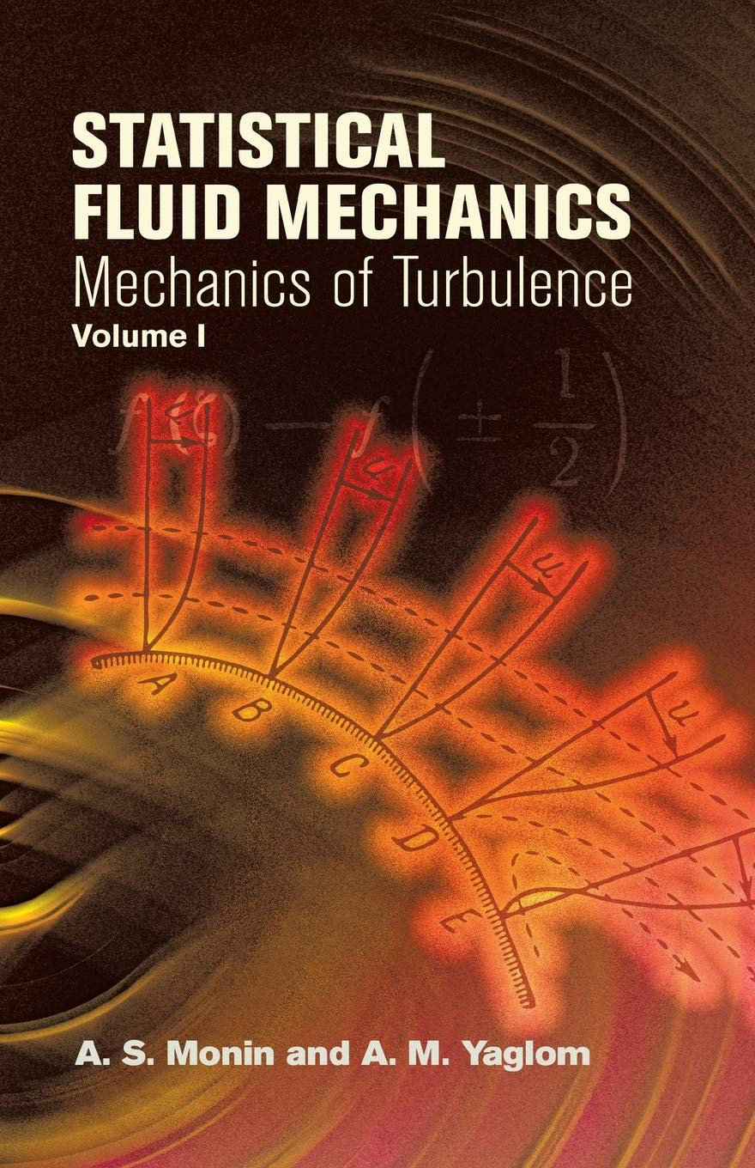
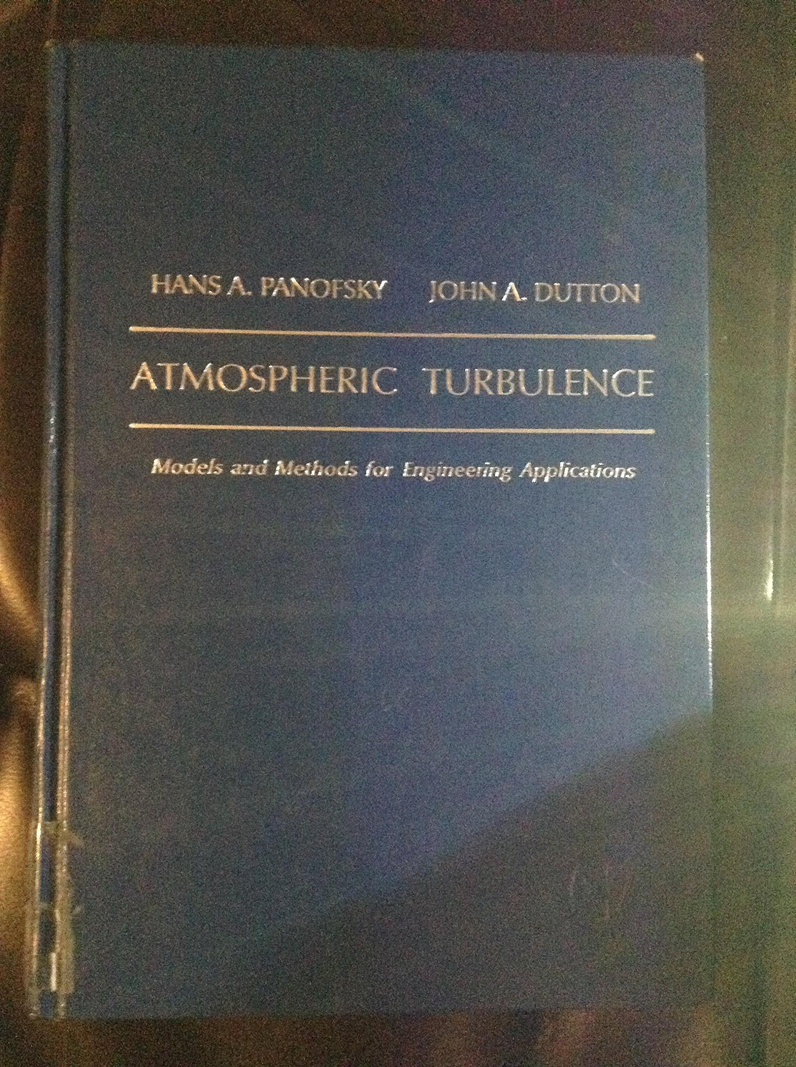
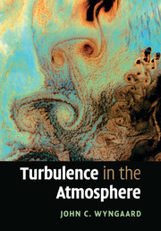
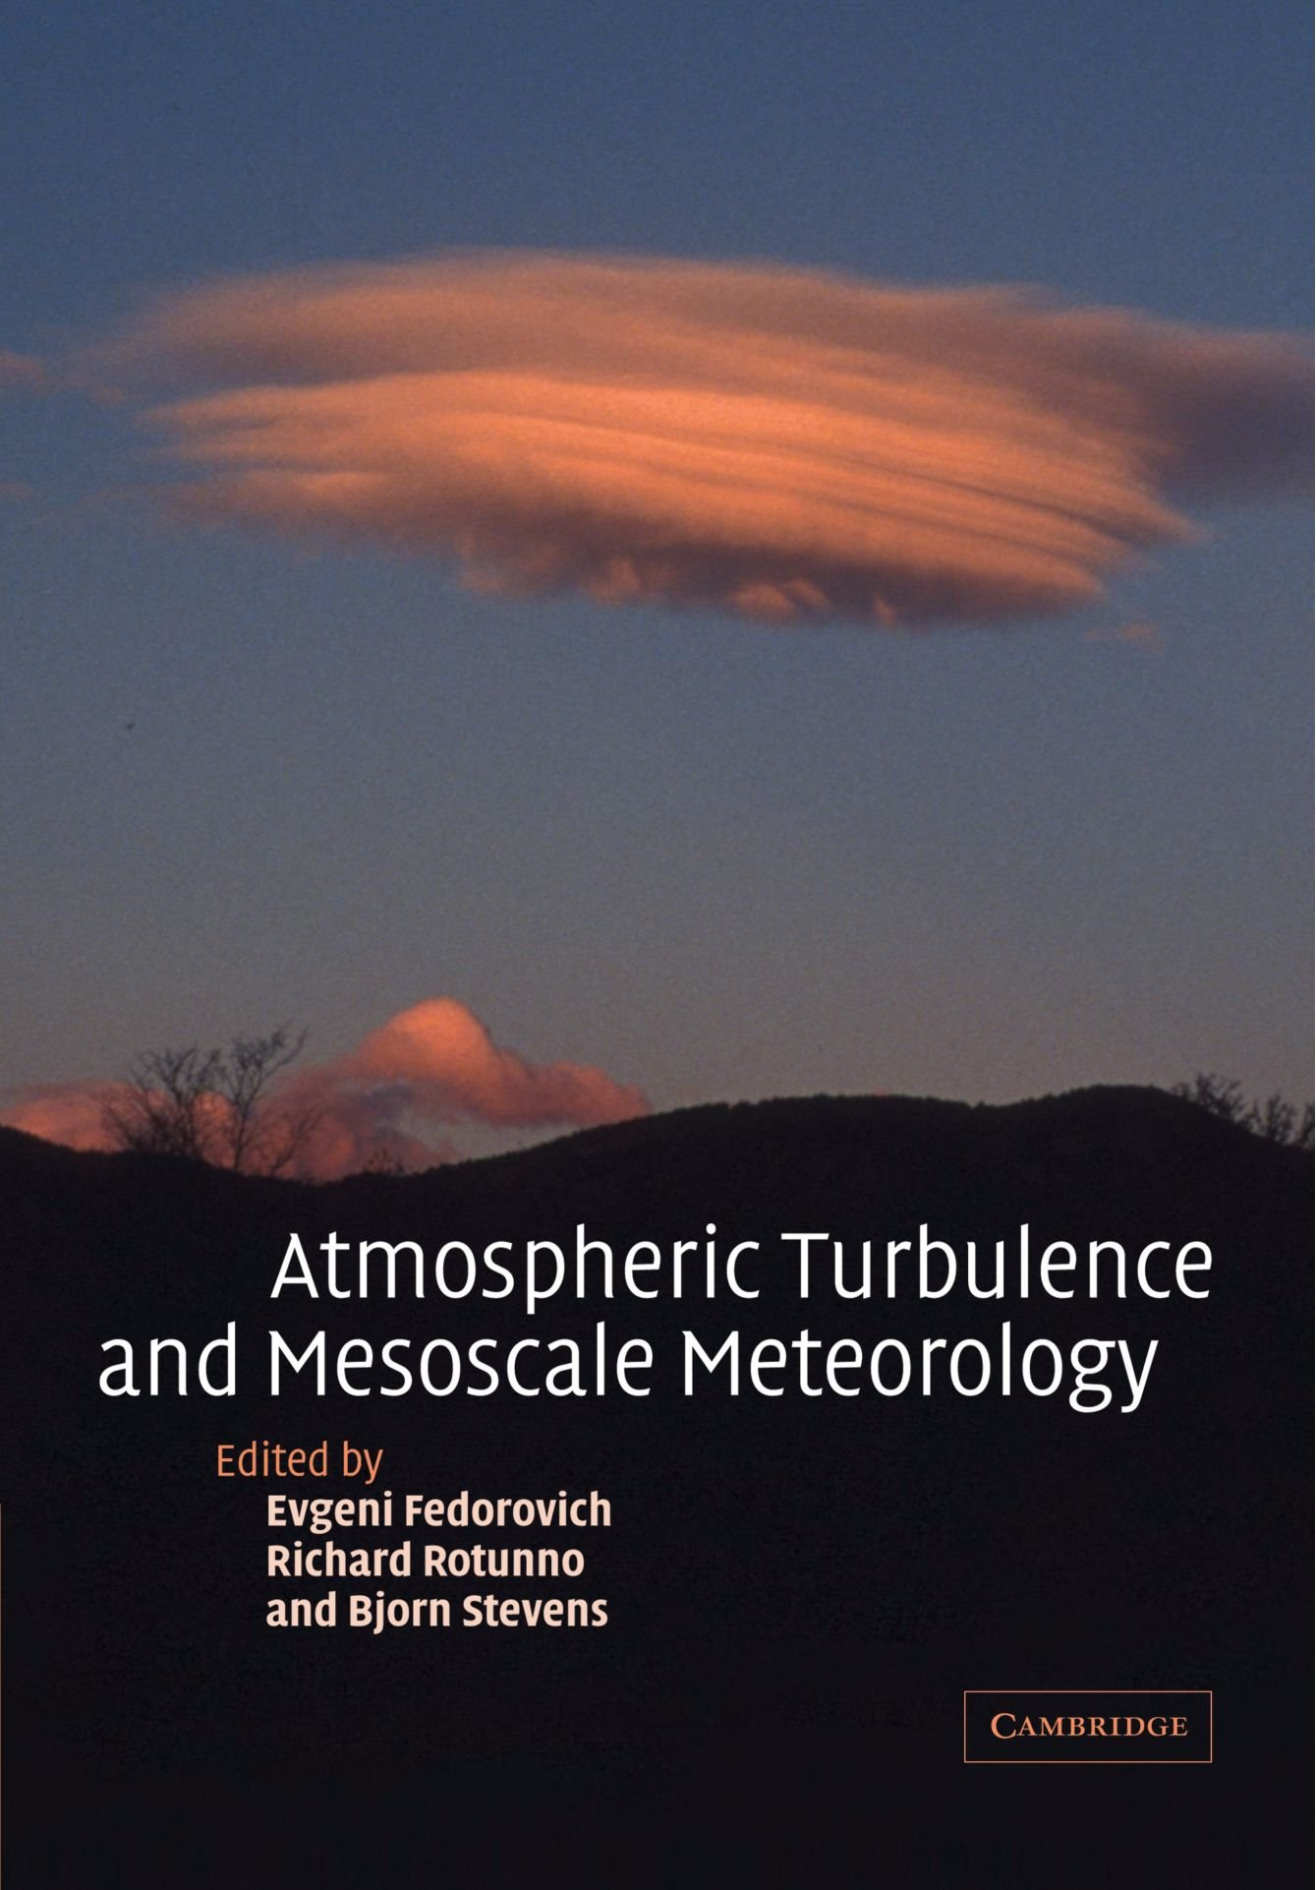
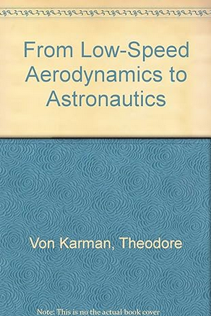
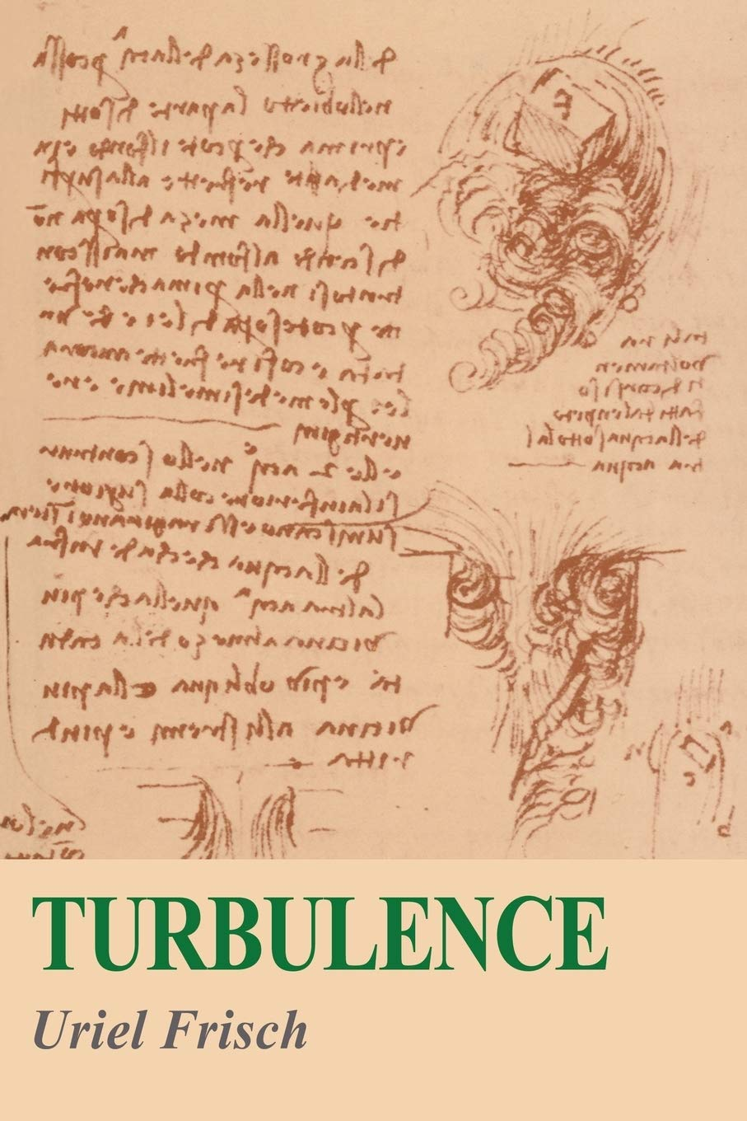
Textbooks on Turbulence
1940
1960
1970
1980
1990
2000
2010
2020

Slide 27



Textbooks about History of Atmospheric Turbulence and its Measurement

Slide 28
Best Thanks for your Attention
19 March 2023, NASA-NOAA Suomi NPP Satellite

